Slide 1
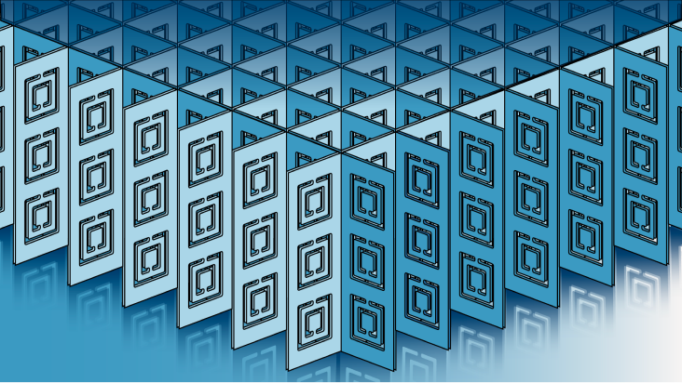
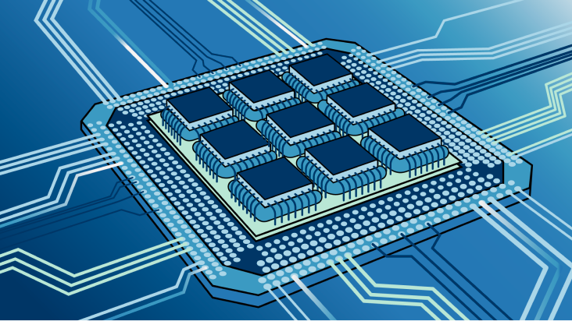
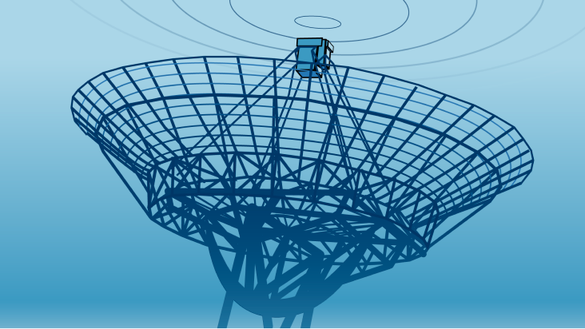
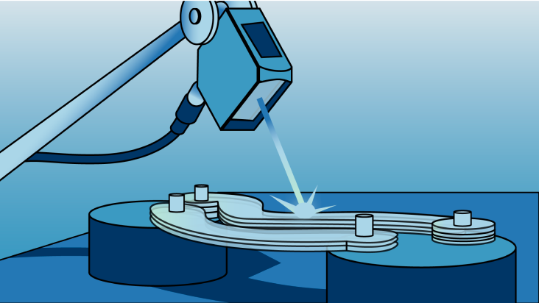
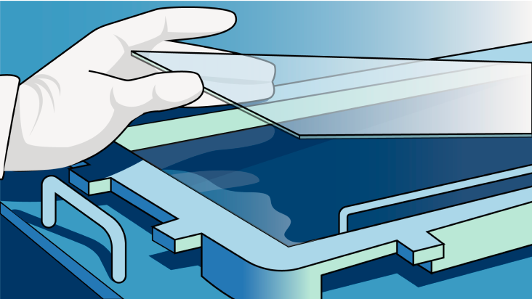
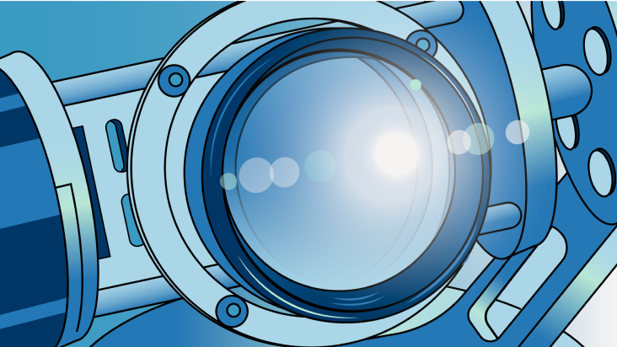
Finite-Difference Time-Domain Method (FDTD)
Metasurfaces
Photonic Integrated Circuits
LIDAR/RADAR
Sensors
Displays
Cameras
Notes:
FDTD means finite-difference time-domain, and it is the numerical method of choice for designing photonic or electromagnetic devices in a broad range of application areas such as metasurfaces, photonic integrated circuits, LIDAR or RADAR, sensors, displays, and cameras. In this short presentation, I will give you an overview of the FDTD method so those unfamiliar with it can know its advantages and how it works.

Slide 2
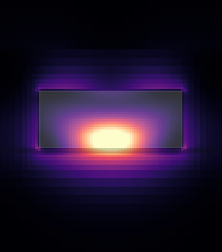
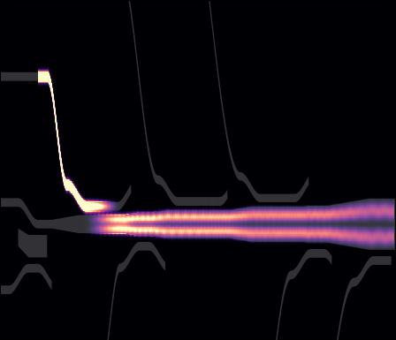
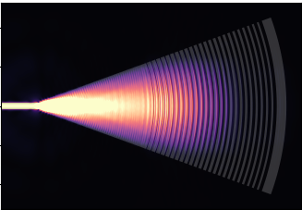
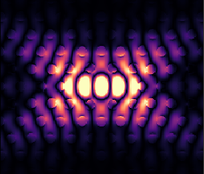
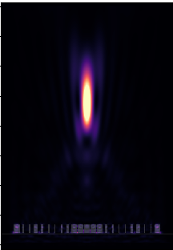
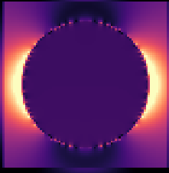
What can FDTD simulations do?
Transmittance
Reflectance
Absorbance
Coupling Efficiency
Dielectric Metasurface
Mode and Polarization Demultiplexer
Grating Coupler
Insertion Losses
Quality Factor
Mode Volume
Far-field radiation
Scattering Cross-section
Metal nanoparticle
PhC Nanocavity
Metalens
Notes:
Using the FDTD method you can simulate light propagating throughout electromagnetic devices and calculate, for example, the transmittance, reflectance, or absorbance of metasurfaces and diffraction gratings, as well as the modal coupling efficiencies in mode and polarization demultiplexers, light insertion losses of grating and edge couplers, find cavity resonances and calculates their quality factor and mode volumes, obtain the far-field radiation of metalenses and antennas, or the scattering cross-section of dielectric and metallic nanoparticles.

Slide 3
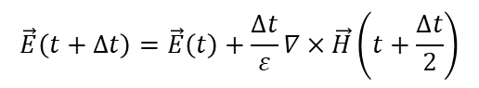
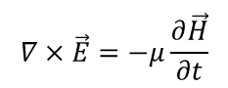
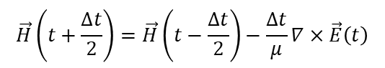
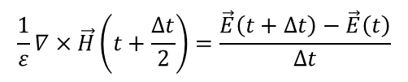
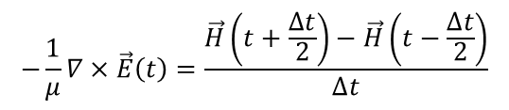
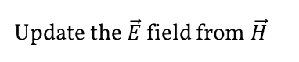
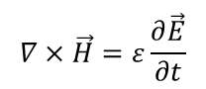
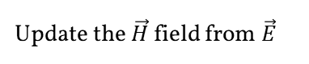
How does an FDTD solver work?
Proposed in 1966 by Kane Yee.
Maxwell’s equations
$$∇×\vec{E}=−μ\frac{∂\vec{H}}{∂t}$$
$$∇×\vec{H}=ε\frac{∂\vec{E}}{∂t}$$
Finite-difference approximations
$$−\frac{1}{μ}∇×\vec{E}\left(t\right)=\frac{\vec{H}\left(t+\frac{∆t}{2}\right)−\vec{H}\left(t−\frac{∆t}{2}\right)}{∆t}$$
$$\frac{1}{ε}∇×\vec{H}\left(t+\frac{∆t}{2}\right)=\frac{\vec{E}\left(t+∆t\right)−\vec{E}\left(t\right)}{∆t}$$
Time loop
Finished?
yes
Results
no
$$\vec{H}\left(t+\frac{∆t}{2}\right)=\vec{H}\left(t−\frac{∆t}{2}\right)−\frac{∆t}{μ}∇×\vec{E}\left(t\right)$$
Update the $\vec{H}$ field from $\vec{E}$
$$\vec{E}\left(t+∆t\right)=\vec{E}\left(t\right)+\frac{∆t}{ε}∇×\vec{H}\left(t+\frac{∆t}{2}\right)$$
Update the $\vec{E}$ field from $\vec{H}$
Notes:
The FDTD method was proposed in 1966 by Kane Yee. In summary, it replaces the spatial and time derivatives of Maxwell's equations, specifically the Faraday and Amper laws, with finite-difference approximations. So, space and time are discretized, and the magnetic and electric fields are evaluated at a staggered grid. The magnetic field half-time step in the future is obtained from the previous magnetic and electric fields, and then the electric field one time step in the future is calculated. This process iterates over time, and the field information is recorded at each time step to obtain the quantities of interest at the end of the simulation.

Slide 4
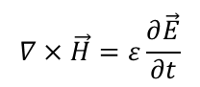
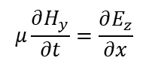
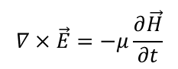
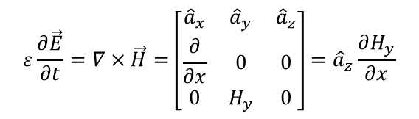

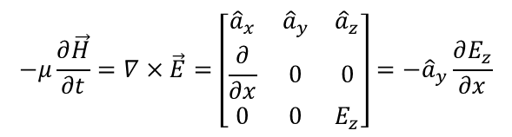

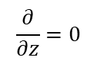

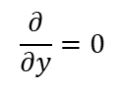
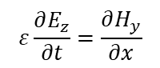
How does an FDTD solver work?
Faraday’s law
Considering material variations only in the x-direction:
$$\frac{∂}{∂y}=0$$
$$\frac{∂}{∂z}=0$$
$$∇×\vec{E}=−μ\frac{∂\vec{H}}{∂t}$$
$$−μ\frac{∂\vec{H}}{∂t}=∇×\vec{E}=\left[\begin{matrix}{\hat{a}}_{x} & {\hat{a}}_{y} & {\hat{a}}_{z} \\ \frac{∂}{∂x} & 0 & 0 \\ 0 & 0 & E_{z}\end{matrix}\right]=−{\hat{a}}_{y}\frac{∂E_{z}}{∂x}$$
E_{z}
k
Ampere’s law
H_{y}
$$∇×\vec{H}=ε\frac{∂\vec{E}}{∂t}$$
z
$$ε\frac{∂\vec{E}}{∂t}=∇×\vec{H}=\left[\begin{matrix}{\hat{a}}_{x} & {\hat{a}}_{y} & {\hat{a}}_{z} \\ \frac{∂}{∂x} & 0 & 0 \\ 0 & H_{y} & 0\end{matrix}\right]={\hat{a}}_{z}\frac{∂H_{y}}{∂x}$$
-y
x
Maxwell’s scalar equations
$$μ\frac{∂H_{y}}{∂t}=\frac{∂E_{z}}{∂x}$$
$$ε\frac{∂E_{z}}{∂t}=\frac{∂H_{y}}{∂x}$$
Notes:
To better understand the FDTD method, let's consider the case of a one-dimensional space where there are variations in the x-direction only, and light is polarized in the z-direction. Hence, Ez and Hy are the only non-zero field components. In this case, the derivatives concerning the y-and z-directions are zero. Then, we can obtain two scalar equations to describe light propagation from the vectorial forms of Faraday and Ampere's law.

Slide 5
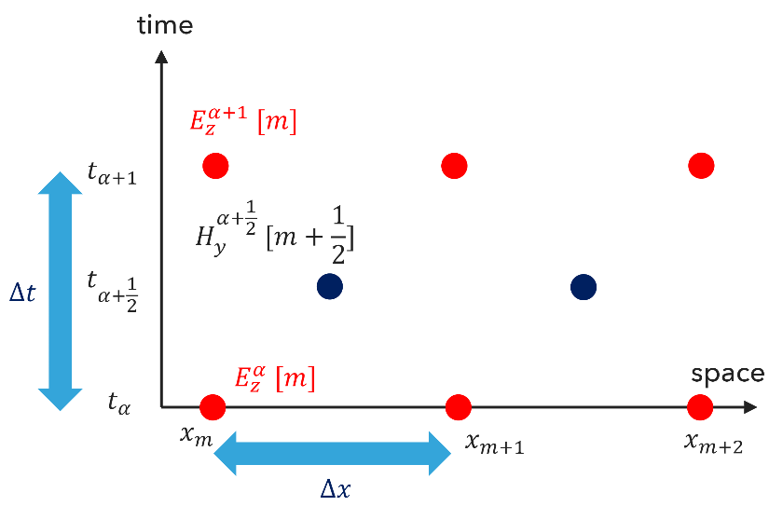
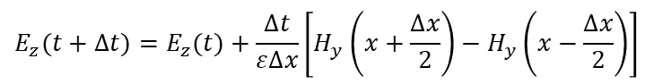
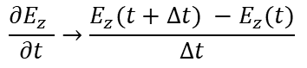
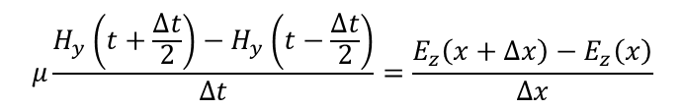
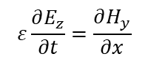
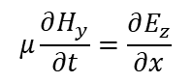
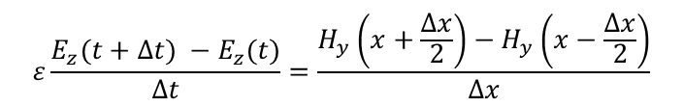
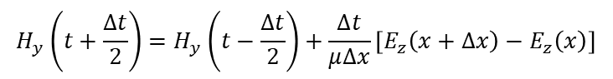
How does an FDTD solver work?
Maxwell’s scalar equations
Yee Grid
Spatial step size: Δx
Temporal step size: Δt
Staggered E and H in space and time
Convert differential operator to difference operator, for example:
$$μ\frac{∂H_{y}}{∂t}=\frac{∂E_{z}}{∂x}$$
$$ε\frac{∂E_{z}}{∂t}=\frac{∂H_{y}}{∂x}$$
$$\frac{∂E_{z} }{∂t}→\frac{E_{z}(t+∆t) −E_{z}(t)}{∆t}$$
Update equations
Finite-difference equations
$$H_{y}\left(t+\frac{∆t}{2}\right)=H_{y}\left(t−\frac{∆t}{2}\right)+\frac{∆t}{μ∆x}\left[E_{z}\left(x+∆x\right)−E_{z}\left(x\right)\right]$$
$$μ\frac{H_{y}\left(t+\frac{∆t}{2}\right)−H_{y}\left(t−\frac{∆t}{2}\right)}{∆t}=\frac{E_{z}\left(x+∆x\right)−E_{z}\left(x\right)}{∆x}$$
$$E_{z}(t+∆t)=E_{z}(t)+\frac{∆t}{ε∆x}\left[H_{y}\left(x+\frac{∆x}{2}\right)−H_{y}\left(x−\frac{∆x}{2}\right)\right]$$
$$ε\frac{E_{z}(t+∆t) −E_{z}(t)}{∆t}=\frac{H_{y}\left(x+\frac{∆x}{2}\right)−H_{y}\left(x−\frac{∆x}{2}\right)}{∆x}$$
Notes:
Now, if we discretize the space using a spatial step size Dx and time using a temporal step size Dt, we can convert the differential operators to a difference one, like in this example. This allows us to obtain the finite-difference versions of Maxwell's scalar equations. From the finite-difference equations, we can get the update equations for the magnetic and electric fields.

Slide 6
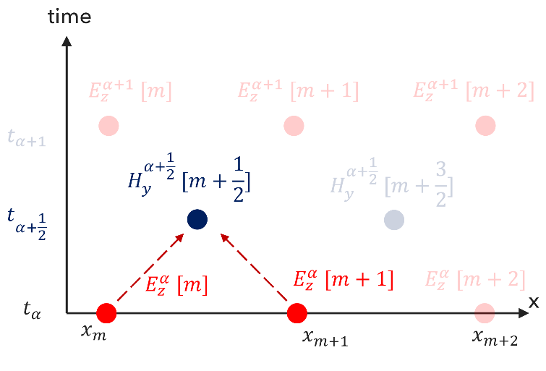
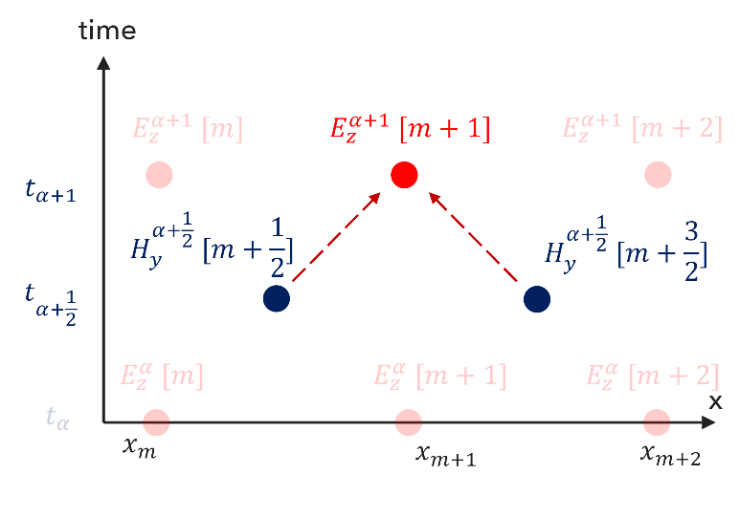

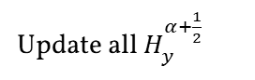
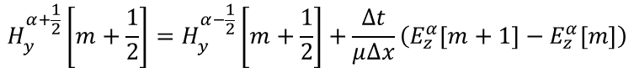
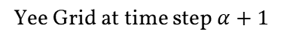
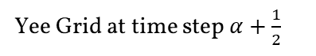
How does an FDTD solver work?
Yee Grid at time step $α+\frac{1}{2}$
Yee Grid at time step $α+1$
Update all $H_{y}^{α+\frac{1}{2}}$
Update $E_{z}^{α+1}$
$$H_{y}^{α+\frac{1}{2}}\left[m+\frac{1}{2}\right]=H_{y}^{α−\frac{1}{2}}\left[m+\frac{1}{2}\right]+\frac{∆t}{μ∆x}\left(E_{z}^{α}\left[m+1\right]−E_{z}^{α}\left[m\right]\right)$$
$$E_{z}^{α+1}\left[m+1\right]=E_{z}^{α}\left[m+1\right]+\frac{∆t}{ε∆x}\left(H_{y}^{α+\frac{1}{2}}\left[m+\frac{3}{2}\right]−H_{y}^{α+\frac{1}{2}}\left[m+\frac{1}{2}\right]\right)$$
Notes:
Here, we have an illustration of the time-stepping process, where given the initial field values at the time step alpha and positions m, we can calculate all the Hy fields at the time step alpha plus half, then calculate the electric fields at the time step alpha plus one, and so forth.

Slide 7
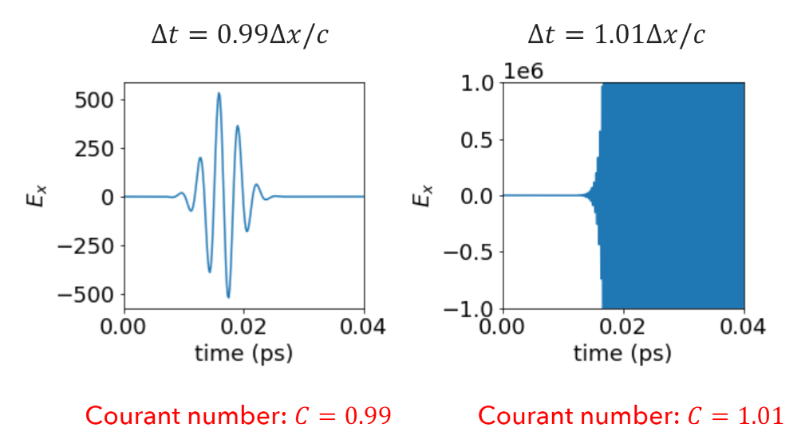
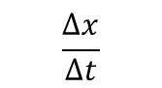
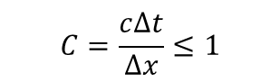


How does an FDTD solver work?
Physical light speed
Numerical light speed
Courant number:
$$c$$
$$≤$$
$$\frac{∆x}{∆t}$$
$$C=\frac{c∆t}{∆x}≤1$$
The minimum time step is limited by the spatial grid size.
Notes:
The maximum distance a physical wave can propagate in a single time step is c x Dt. Thus, this distance should be smaller than the numerical grid size. Thus, the physical speed of light limits the numerical grid size. From this inequality, we derive the Courant number, an important parameter for the stability of FDTD simulations. As one can see from these images, the simulation can diverge if the Courant number is higher than 1.

Slide 8
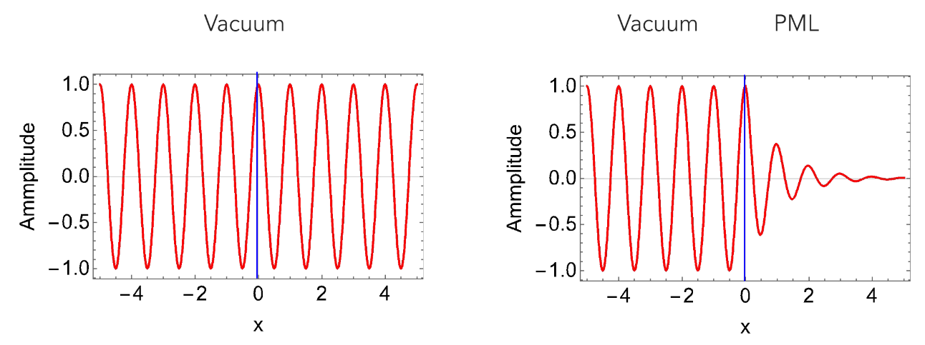
How does an FDTD solver work?
Boundary Conditions:
Absorbing Boundary Condition
?
$$E_{z}^{α+1}\left[m+2\right]=E_{z}^{α}\left[m+2\right]+\frac{∆t}{ε∆x}\left(H_{y}^{α+\frac{1}{2}}\left[m+\frac{5}{2}\right]−H_{y}^{α+\frac{1}{2}}\left[m+\frac{3}{2}\right]\right)$$
Notes:
We have special cases at the boundaries of the numerical grid, as we don't have enough information to compute the spatial derivatives. So, we need to modify the update equations to deal with these cases. If we consider the fields at the positions beyond the boundaries as zero, we can introduce artificial reflections, which in most cases are not desired. There are many ways to tackle this situation; one of the most popular is the inclusion of absorbing boundary conditions, like Perfect Matched Layers (PML), which completely absorb the incoming wave, creating an illusion of continuity.

Slide 9
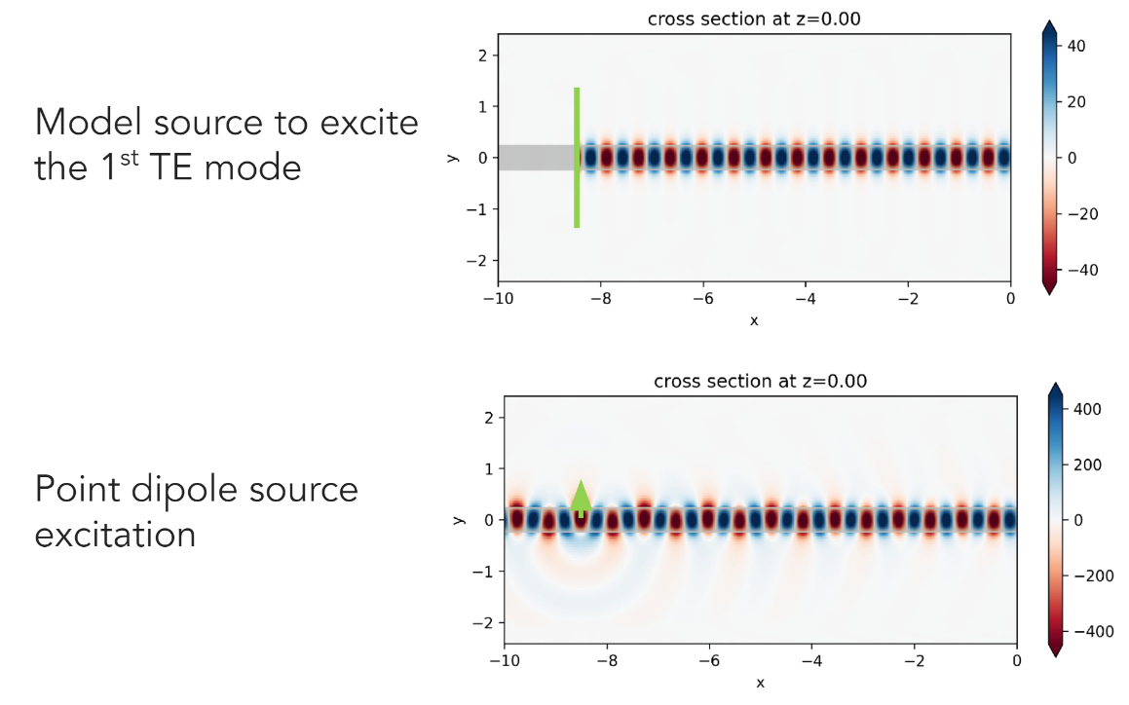
How does an FDTD solver work?
Source
Notes:
Lastly, we need to include a source of electromagnetic waves in the simulation. Otherwise, the fields are going to be always null. There are many different source types, such as mode sources, point dipole sources, plane wave sources, or Gaussian beam sources. Usually, the source is injected as a Gaussian pulse whose time profile is calculated to include all the frequency components of interest.

Slide 10
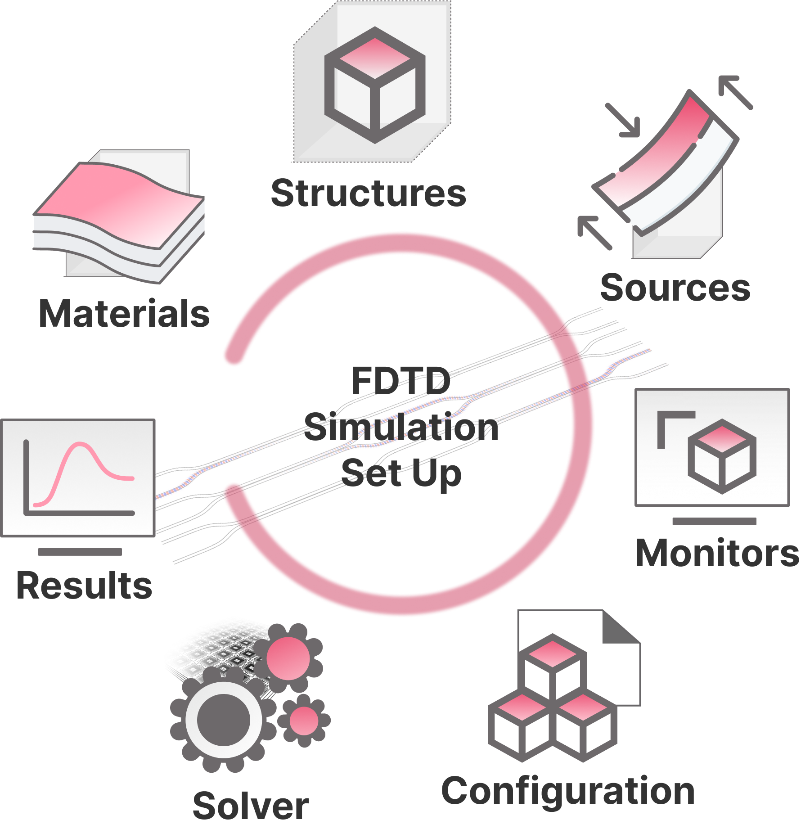

How to set up a FDTD simulation
Notes:
When setting up FDTD simulations you need to define the materials, structures, sources and monitors. Then configure the simulation parameters such as grid discretization, boundary conditions, and run time. Finally, after running the FDTD solver you are going to have the raw electromagnetic data to calculate the quantities of interest.

Slide 11
Conclusion
Maxwell’s equations are approximated by finite-differences.
FDTD can obtain the response for multiple frequencies in a single simulation.
The FDTD algorithm should include:
Structures and Materials
Discretization
Update equations
Boundary Conditions
Sources
Monitors
Notes:
Concluding, an FDTD algorithm discretizes Maxwell's equations in time and space and iterates over the finite-difference equations to propagate the electromagnetic fields. It lets us obtain the device response for multiple frequencies in a single simulation. The complete FDTD algorithm needs to describe the materials and structures over a numerical grid, it should have an efficient scheme to update the electric and magnetic fields, includes boundary conditions and sources, as well as monitor planes where to record the fields to calculate the quantities of interest.

Slide 12



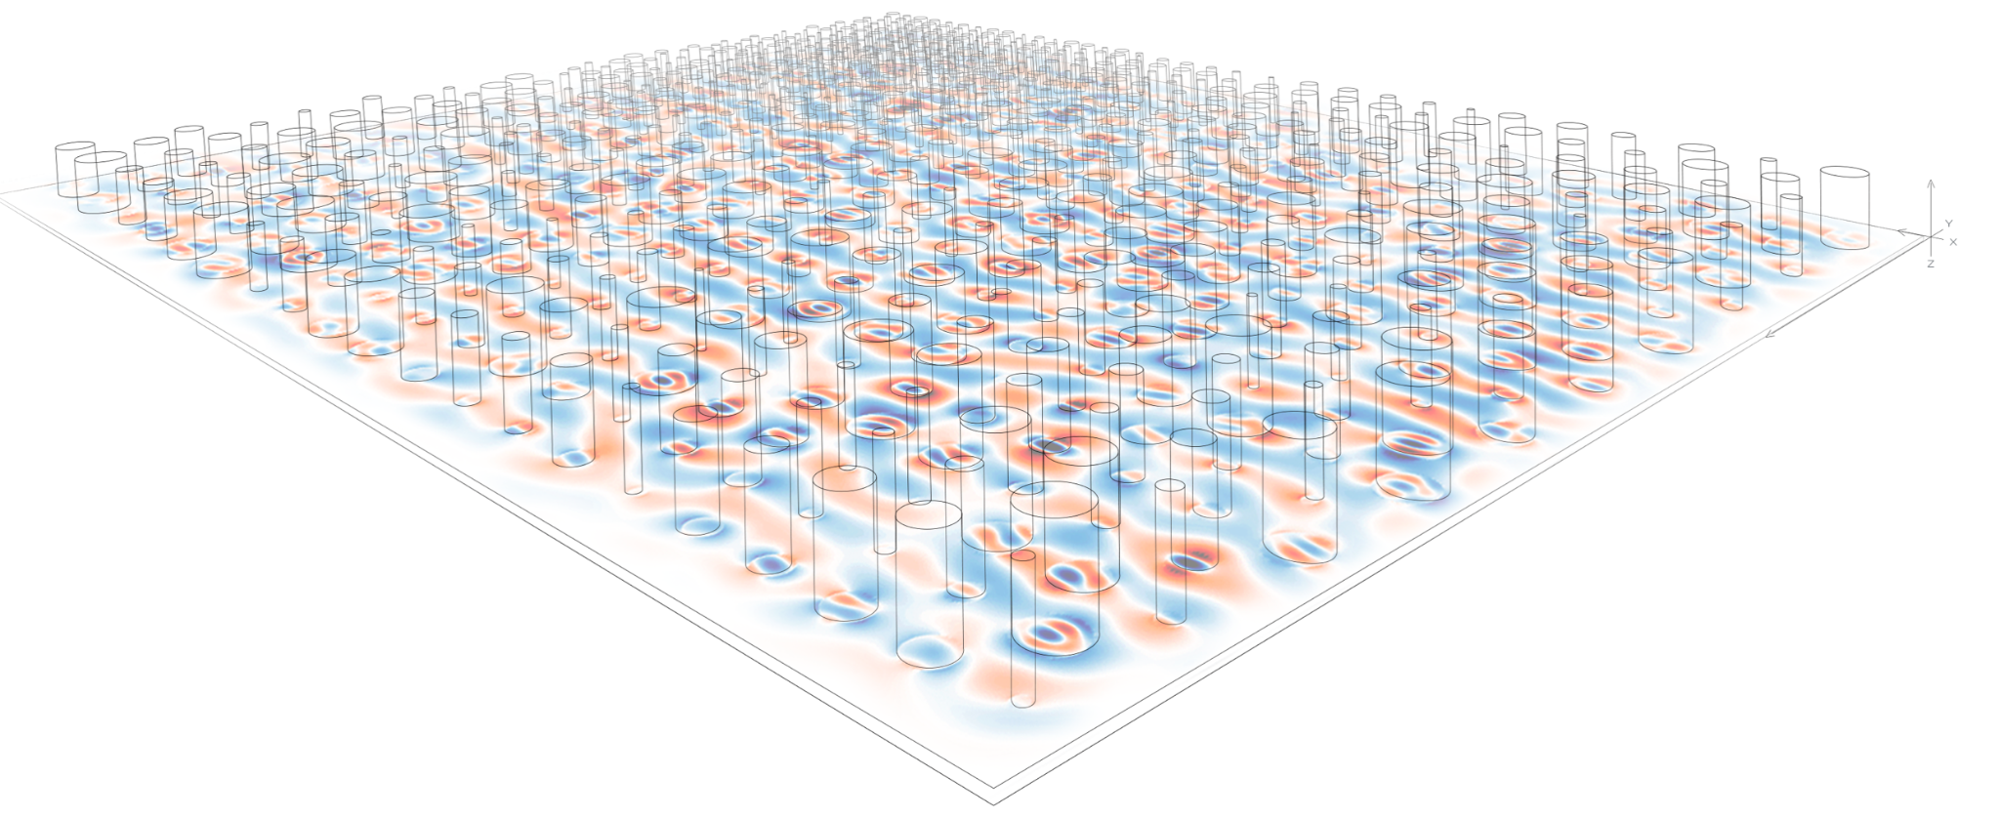
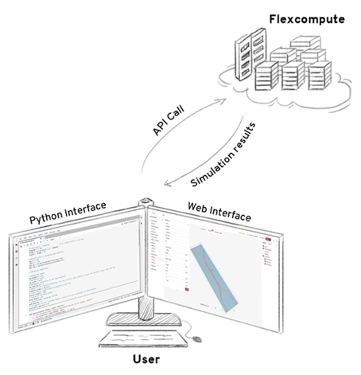




Learn FDTD, from basics to advanced topics.
Cloud-based FDTD solver
100–1000X larger
Explore various FDTD simulation examples, such as photonic integrated circuits, metasurfaces, photonic crystals, metalenses, inverse designs, and more.
10–100X faster
Python-based User Interface
Graphical User Interface
Learn the adjoint-based inverse design method.
Step-by-step tutorials on using Tidy3D graphical user interface (GUI). Practical examples included.
Complete documentation to Python-based Tidy3D user interface.
Notes:
On the Tidy3D website, we have a lot of resources where you can learn more about FDTD.

